Slide 1


K.RAMAKRISHNAN COLLEGE OF TECHNOLOGY
(AUTONOMOUS), TRICHY.
ALUMNI MANAGEMENT SYSTEM
PRESENTED
HARIVARSHINI G
2303811710422059
SUPERVISOR
Mr. M. Saravanan, M.E.,
AP/CSE.
Notes:
‹#›

Slide 2
PRESENTATION OVERVIEW
Objective
Project Introduction
Problem Statement
Methodologies (Programming concepts relevant to problem statement)
Architecture of the proposed system
List of Modules
Merits
Results and Discussion
Queries
Notes:
‹#›

Slide 3
OBJECTIVE
The objective of an Alumni Management System (AMS) is to facilitate and strengthen the relationship between an educational institution and its former students. By creating a centralized platform, the system allows the institution to efficiently maintain a database of alumni, track their professional progress, and engage them in various activities. AMS aims to promote networking opportunities, collaboration, and support for current students, as alumni can offer mentorship, internships, or job opportunities. Additionally, the system helps to organize events, reunions, and fundraising initiatives, encouraging alumni to contribute to the institution's development.
Notes:
‹#›

Slide 4
PROJECT INTRODUCTION
An Alumni Management System (AMS) is a software platform designed to manage and engage an institution's alumni community. It allows educational institutions, such as schools, colleges, and universities, to maintain detailed records of their former students, track their achievements, and facilitate communication. The system typically includes features like profile management, event scheduling, job and mentorship opportunities, donation tracking, and alumni networking. By centralizing this data, an AMS helps institutions foster stronger relationships with their alumni, encourage donations and support, and provide alumni with networking opportunities that can benefit both their professional and personal growth.
Notes:
‹#›

Slide 5
PROBLEM STATEMENT
The problem with managing alumni data and engagement manually is that it becomes time-consuming, inefficient, and prone to errors. Educational institutions often struggle to maintain up-to-date records, track alumni interactions, and foster meaningful connections between alumni and the institution. Without a centralized system, it becomes difficult to organize events, offer career support, and encourage alumni contributions or mentorship. An effective Alumni Management System (AMS) addresses these challenges by automating processes, improving communication, and enhancing alumni relations, leading to more successful long-term engagement.
Notes:
‹#›

Slide 6
METHODOLOGIES
Agile Methodology: This iterative approach allows the development team to work in cycles (sprints), providing flexibility to adapt to changing requirements and incorporating regular feedback from stakeholders (such as alumni and institutional staff).
Object-Oriented Programming (OOP): This methodology structures the system using objects and classes, promoting reusability, scalability, and easier maintenance.
Database Management: A relational database management system (RDBMS) is typically used to store and manage alumni data.
User-Centered Design (UCD): This design methodology focuses on understanding the needs, behaviors, and goals of users (alumni and administrators) to ensure the system is intuitive and user-friendly
Notes:
‹#›

Slide 7
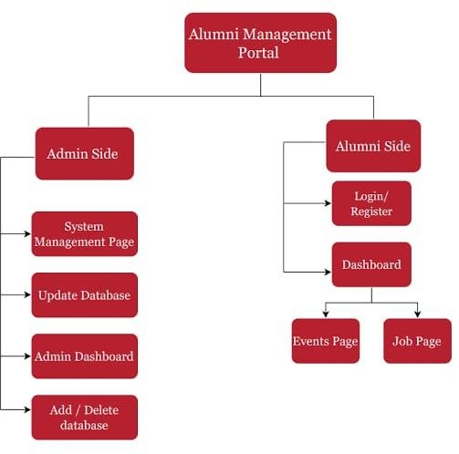
ARCHITECTURE OF THE PROPOSED SYSTEM
Notes:
‹#›

Slide 8
LIST OF MODULES
Alumni Class – Stores and handles data for each alumni.
Alumni Management System Class – Manages the overall system, like adding, searching, and displaying alumni.
Main Method – The entry point of the program, where the user interacts with the system.
Validation Methods – Ensures correct input for year and email.
Notes:
‹#›

Slide 9
LIST OF MODULES
Add Alumni: The user selects "Add Alumni" and enters details like name, year of graduation, course, email, and the list of modules.
Display Alumni: The user selects "Display Alumni" to see all the added alumni’s details, including their modules.
Search Alumni: The user selects "Search Alumni by Name" and enters a name to find specific alumni.
Exit: The user can choose to exit the program.
2/7/20

Slide 10
MERITS
Centralized Data Management: AMS allows institutions to maintain an organized, up-to-date database of alumni, making it easier to track and manage alumni information, interactions, and contributions in one place.
Improved Communication: The system facilitates seamless communication between the institution and alumni, whether through newsletters, event invitations, or job opportunities, ensuring strong and ongoing engagement.
Networking Opportunities: AMS creates a platform for alumni to connect, share experiences, and offer mentorship, fostering a sense of community and supporting professional growth.
Event Management: It simplifies organizing and managing alumni events, reunions, and networking opportunities by automating processes such as registration, invitations, and reminders
Data Security: AMS ensures that alumni data is stored securely with encryption and access control, providing peace of mind regarding privacy and data protection.
Time and Cost Efficiency: By automating processes such as data collection, communication, and event organization, AMS reduces administrative workload, saving time and reducing operational costs.
Notes:
‹#›

Slide 11
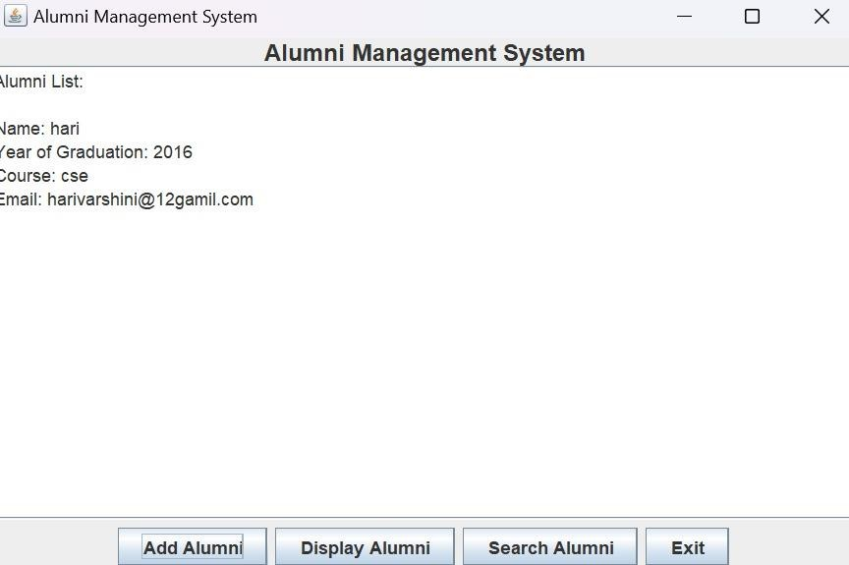
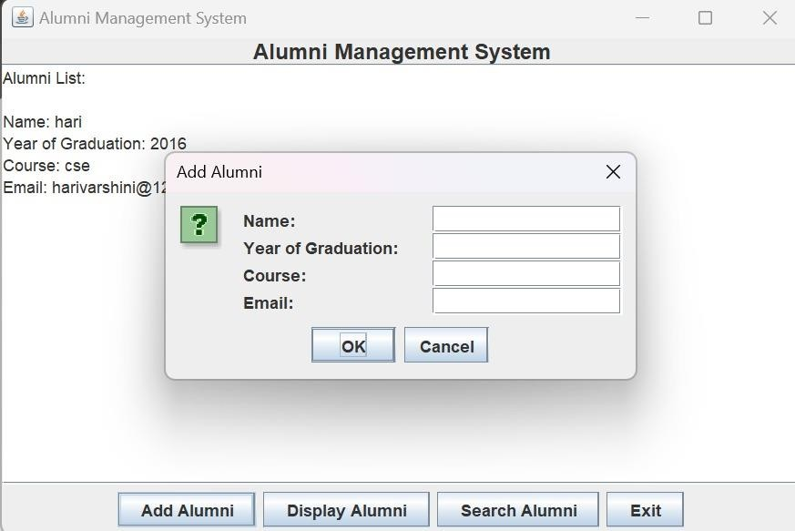
RESULTS AND DISCUSSION
Notes:
‹#›

Slide 12
QUERIES ?
Notes:
‹#›

